Slide 1
The Periodic Table
How the periodic table is put together

Slide 2
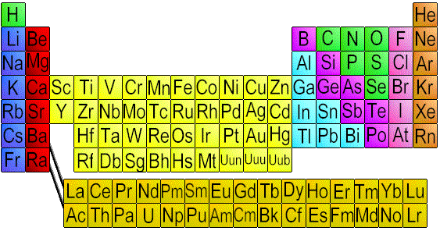

Slide 3
What is the Periodic Table?
It is an organizational system for elements.

Slide 4
Who created it?
By 1860 about 60 elements were known and a method was needed for organization.
In 1869, Russian chemist Dimitri Mendeleev proposed arranging elements by atomic weights and properties.
The table contained gaps but Mendeleev predicted the discovery of new elements.

Slide 5
So how is it arranged?
The genius of the periodic table “is that it is organized like a big grid. The elements are placed in specific places because of the way they look and act. If you have ever looked at a grid, you know that there are rows (left to right) and columns (up and down). The periodic table has rows and columns, too, and they each mean something different.”

Slide 6
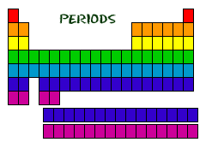
You've got Your Periods...
Even though they skip some squares in between, all of the rows go left to right. When you look at a periodic table, each of the rows is considered to be a different period (Get it? Like PERIODic table.)

Slide 7
Periods = Rows
In the periodic table, elements have something in common if they are in the same row.
All of the elements in a period have the same number of occupied energy levels.
Every element in the top row (the first period) has one energy level for its electrons. All of the elements in the second row (the second period) have two energy levels for their electrons. It goes down the periodic table like that.

Slide 8
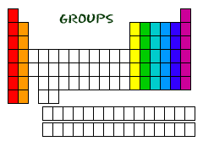
And you got your groups…
The periodic table has a special name for its columns, too. When a column goes from top to bottom, it's called a group.

Slide 9
Groups = Columns
The elements in a group have the same number of electrons in their outer orbital.
Every element in the first column (group one) has one electron in its outer shell. Every element on the second column (group two) has two electrons in the outer shell. As you keep counting the columns, you'll know how many electrons are in the outer shell.
There are some exceptions to the order when you look at the transition elements, but you get the general idea.

Slide 10
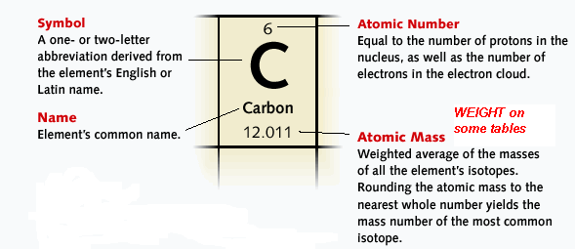
What do all the numbers mean ?

Slide 11
Other than periods and groups, the table is divided into families.

Slide 12
ALKALI METALS
very reactive metals that do not occur freely in nature
malleable, ductile, good conductors of heat and electricity.
can explode if they are exposed to water

Slide 13
ALKLINE EARTH METALS
metals
very reactive (less than Alkali metals)
Harder, denser than group 1
not found free in nature

Slide 14
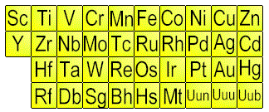
TRANSITION METALS
Shiny, ductile and malleable, form colored compounds and conduct electricity and heat
Can put more than 8 electrons in outer shell
iron, cobalt, and nickel, are the only elements known to produce a magnetic field.

Slide 15
RARE EARTH ELEMENTS
many are man-made
Bottom row are all radioactive
The 4f row is called the Lanthanides b/c it comes after Lanthanum
The 5f row is called the Actinides b/c it comes
after Actinium

Slide 16
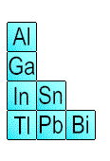
OTHER METALS
are ductile and malleable
are solid, have a high density,

Slide 17
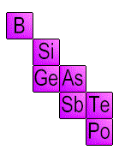
METALLOIDS
have properties of both metals and non-metals
some of the metalloids are semi-conductors. This means that they can carry an electrical charge under special conditions. This property makes metalloids useful in computers and calculators

Slide 18
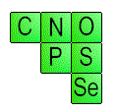
NON-METALS
not able to conduct electricity or heat very well
very brittle
Do not reflect light.

Slide 19
HALOGENS
"halogen" means "salt-former" and compounds containing halogens are called "salts"
exist in all three states of matter. At room temperature, Fluorine and Chlorine are gases, Bromine is a liquid (1 of only 2 elements that is a liquid at room temp) and Iodine and Astatine are solids.

Slide 20
NOBLE GASES
do not form compounds easily
Happy/Inert Elements (Full outer shells)
All have 8 valence electrons except Helium which has a full energy level containing only 2 electrons

